Slide 1
Density Functional Theory
Kapil

Slide 2
Outline
Background
Density Functional Theory
Approximations
  Local Density Approximation (LDA)
  Gradient Expansion Approximation (GEA)
  Generalized Gradient Approximation (GGA)
  Hybrid DFT

Slide 3
ZEN and THE ART of DRIVING !!!
Before you learned how to drive, it was presumably clear to you that you can accomplish many useful things with the aid of a car.
To make good use of a car,
  Understand the basic concepts that control cars.
  Put fuel in the car regularly, follow basic traffic laws, etc.
  Spend time actually driving a car in a variety of road conditions.

Slide 4
ZEN and THE ART of DRIVING !!!
However, you do not need to know every detail of
  how fuel injectors work,
  how to construct a radiator system that efficiently cools an engine,
  other myriad of details.
You can make it across town to a friend’s house and back without understanding those details.
What if you plan to drive yourself across Antarctica?

Slide 5
WAVE FUNCTION
A particle is distributed through space, like a wave.
Represented by the wave function, which is a central quantity in quantum theory.
Often the wave function is denoted by the letter ψ (psi).
The wave function contains all the information that can be determined experimentally, but it is not an experimentally measurable quantity itself.
It is a very complicated function as it depends on the coordinates of every particle.

Slide 6
WAVE FUNCTION
Ψ is a complex function of many variables, one for each particle. For N particles it is a function of their 3N coordinates:

Slide 7

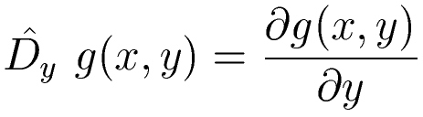
OPERATORS
A different way to write something that you already know !!!
Any change on a function can be represented by an operator.
Examples:
  Multiplication by a number
  Differentiation

Slide 8
OPERATORS
Quantum mechanical operators are the same as their corresponding classical quantities
Classical quantities | QM operators
Position (x) | x
Potential energy [V(x)] | V(x)
Momentum (p_{x})
Kinetic energy (T) | ???

Slide 9


HAMILTONIAN
In quantum mechanics, the Hamiltonian is the operator corresponding to the total energy of the system. It is usually denoted by H.
The Hamiltonian is the sum of the kinetic energies of all the particles, plus the potential energy of the particles associated with the system.

Slide 10
HAMILTONIAN
Hamiltonian of Hydrogen atom:

Slide 11
Background
Hamiltonian of a molecule is given by
K.E. of electrons
Electrons-nuclei interaction
Nucleus-nucleus interaction
K.E. of nuclei
Electron-electron interaction

Slide 12
The Born-Oppenheimer Approximation
≈0
Constant
Electrons in a molecule moves in the field of fixed nuclei
Any constant added to an operator only adds to the operator eigenvalues and has no effect on the operator eigenfunctions.

Slide 13
Atomic Unit
Let us take Schrodinger equation for the hydrogen atom in S.I. unit-
Choose λ such that:
E_{a} is the atomic unit of energy called Hartree.
Thus λ is just the Bohr radius a₀ which is the atomic unit of length called a Bohr.

Slide 14
Atomic Unit
which is the Schrodinger equation in atomic units.
Table: Conversion of atomic units to SI units
Physical quantity | Conversion factor x | Value of x (S.I.)
Length | a₀ | 5.2918×10⁻¹¹ m
Mass | m_{e} | 9.1095×10⁻³¹ kg
Charge | e | 1.6022×10⁻¹⁹ C
Energy | E_{a} | 4.3598×10⁻¹⁸J
Angular momentum | ħ | 1.0546×10⁻³⁴ Js

Slide 15
Atomic Unit

Slide 16

An Ode to A Flower: Feynman

Slide 17

Schrodinger Equation
Electronic Wave function
Solutions (eigenfunctions) of the electronic Schrödinger equation (i.e. under the Born-Oppenheimer approximation)
Electronic wavefunctions, whether exact or approximate, must have the following properties:
  Be finite
  Be continuous
  Continuous first-order derivate
  Be single valued
  Respect the indistinguishability of electrons
  They must be anti-symmetric

Slide 18

Wavefunctions of Fermions change sign when the coordinates (space and spin) of any two particles are exchanged.
This property is called antisymmetry:
Electrons are Fermions, therefore electronic wavefunctions must be antisymmetric
We need to include antisymmetry in all approximate wave functions we construct
$$Ψ\left(r_{1},r_{2}\right)=−Ψ\left(r_{2},r_{1}\right)$$

Slide 19

Indistinguishability of electrons
If you can tell the particles apart (i.e. they have different mass, charge, etc.) then the state of the two-particle system is just a product of the individual states of the two particles a and b:
$$Ψ\left(r_{1},r_{2}\right)=Ψ_{a}\left(r_{1}\right)Ψ_{b}\left(r_{2}\right)$$
If the two particles are utterly identical, then we don't (and can't even in principle) know which one is in which state. So our two-particle wavefunction has to be non-committal as to which particle is in which state. There turns out to be two equally valid ways to do this:
$$Ψ_{±}\left(r_{1},r_{2}\right)=A\left[Ψ_{a}\left(r_{1}\right)Ψ_{b}\left(r_{2}\right)±Ψ_{b}\left(r_{1}\right)Ψ_{a}\left(r_{2}\right)\right]$$
(Where A is the normalization factor.)
A short comment on Fermions, Bosons and Pauli exclusion principle.

Slide 20
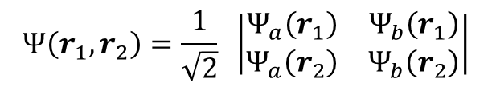
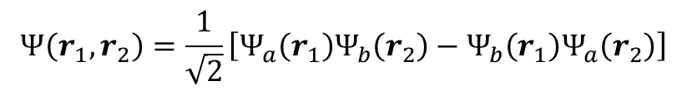
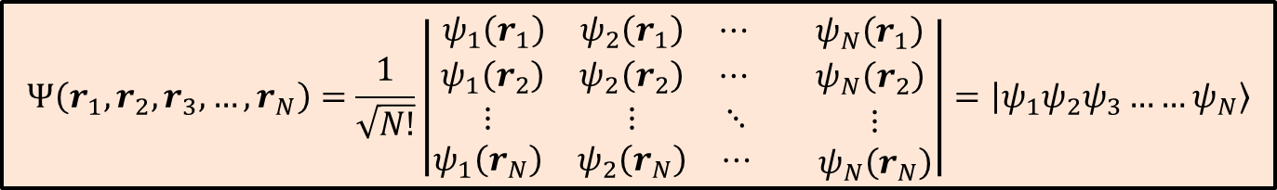
Slater Determinant
$$Ψ\left(r_{1},r_{2}\right)=\frac{1}{\sqrt{2}}\left[Ψ_{a}\left(r_{1}\right)Ψ_{b}\left(r_{2}\right)−Ψ_{b}\left(r_{1}\right)Ψ_{a}\left(r_{2}\right)\right]$$
$$Ψ\left(r_{1},r_{2}\right)=\frac{1}{\sqrt{2}} \left|\begin{matrix}Ψ_{a}\left(r_{1}\right) & Ψ_{b}\left(r_{1}\right) \\ Ψ_{a}\left(r_{2}\right) & Ψ_{b}\left(r_{2}\right)\end{matrix}\right|$$
$$Ψ\left(r_{1},r_{2},r_{3},…,r_{N}\right)=\frac{1}{\sqrt{N!}}\left|\begin{aligned}\begin{matrix}ψ_{1}\left(r_{1}\right) & ψ_{2}\left(r_{1}\right) & ⋯\end{matrix}\begin{matrix} & ψ_{N}\left(r_{1}\right)\end{matrix} \\ \begin{matrix}ψ_{1}\left(r_{2}\right) & ψ_{2}\left(r_{2}\right) & ⋯\end{matrix}\begin{matrix} & ψ_{N}\left(r_{2}\right)\end{matrix} \\ \begin{matrix}⋮ & ⋮ & ⋱ \\ ψ_{1}\left(r_{N}\right) & ψ_{2}\left(r_{N}\right) & ⋯\end{matrix}\begin{matrix} & ⋮ \\ & ψ_{N}\left(r_{N}\right)\end{matrix}\end{aligned}\right|=\left|\left.ψ_{1}ψ_{2}ψ_{3}……ψ_{N}\right\rangle \right.$$

Slide 21



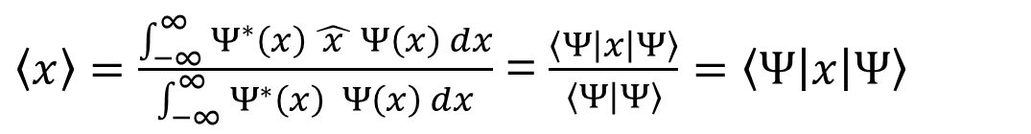
Expectation values
Experimental measurements of physical properties are average values
In quantum mechanics:
$\left\langle x\right\rangle =\frac{\int_{−∞}^{∞}{Ψ^{∗}\left(x\right)\hat{ x }Ψ\left(x\right) dx}}{\int_{−∞}^{∞}{Ψ^{∗}\left(x\right) Ψ\left(x\right) dx}}$ = $\frac{\left\langle Ψ | x | Ψ\right\rangle }{\left\langle Ψ | Ψ\right\rangle }=\left\langle Ψ | x | Ψ\right\rangle$
$$E=\left\langle \hat{H}\right\rangle =\left\langle Ψ | H | Ψ\right\rangle$$

Slide 22

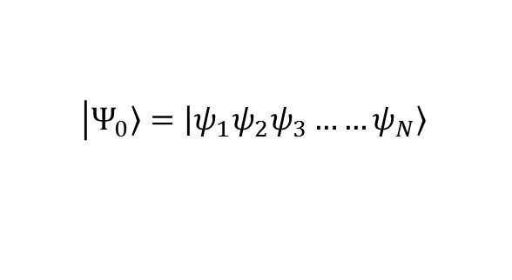
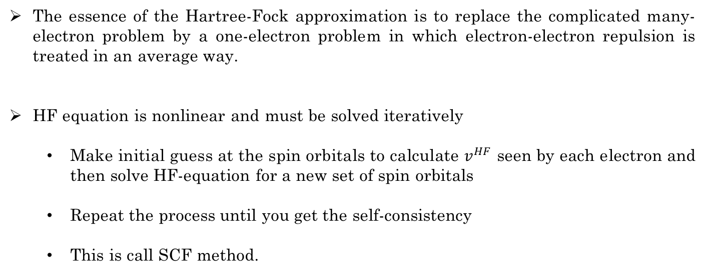
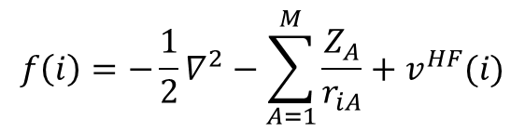

Hartree-Fock approximation
$$\left|\left.Ψ_{0}\right\rangle =\left|\left.ψ_{1}ψ_{2}ψ_{3}……ψ_{N}\right\rangle \right.\right.$$
$$E=\left\langle Ψ_{0} | \hat{ℋ} | Ψ_{0}\right\rangle$$
$$f\left(i\right) ψ\left(r_{i}\right)=ε ψ\left(r_{i}\right)$$
Hartree-Fock eq^{n}
$$f\left(i\right)=−\frac{1}{2}∇_{}^{2}−\sum_{A=1}^{M}{\frac{Z_{A}}{r_{iA}}}+v^{HF}(i)$$
Average potential experienced by the i^{th} electron due to presence of other electons.
The essence of the Hartree-Fock approximation is to replace the complicated many-electron problem by a one-electron problem in which electron-electron repulsion is treated in an average way.
HF equation is nonlinear and must be solved iteratively
  Make initial guess at the spin orbitals to calculate $v^{HF}$ seen by each electron and then solve HF-equation for a new set of spin orbitals
  Repeat the process until you get the self-consistency
  This is call SCF method.

Slide 23



Variational Principle
Suppose you want to calculate the ground-state energy for a system described by the Hamiltonian H,
$$E_{g}=\left\langle Ψ_{exact} | \hat{H} | Ψ_{exact}\right\rangle$$
but you are unable to solve the Schrodinger equation. Pick any wave function $Ψ_{approx}$ whatsoever
$$E_{approx}=\left\langle Ψ_{approx} | \hat{H} | Ψ_{approx}\right\rangle$$
$$E_{g}≤E_{approx}$$
Computational techniques in quantum chemistry make use of the variational principle: the lower the energy, the better the approximation.

Slide 24
Density functional theory
DFT works with n(r) instead of Ψ.
Standard approach of QM :
DFT : work in terms of density :

Slide 25
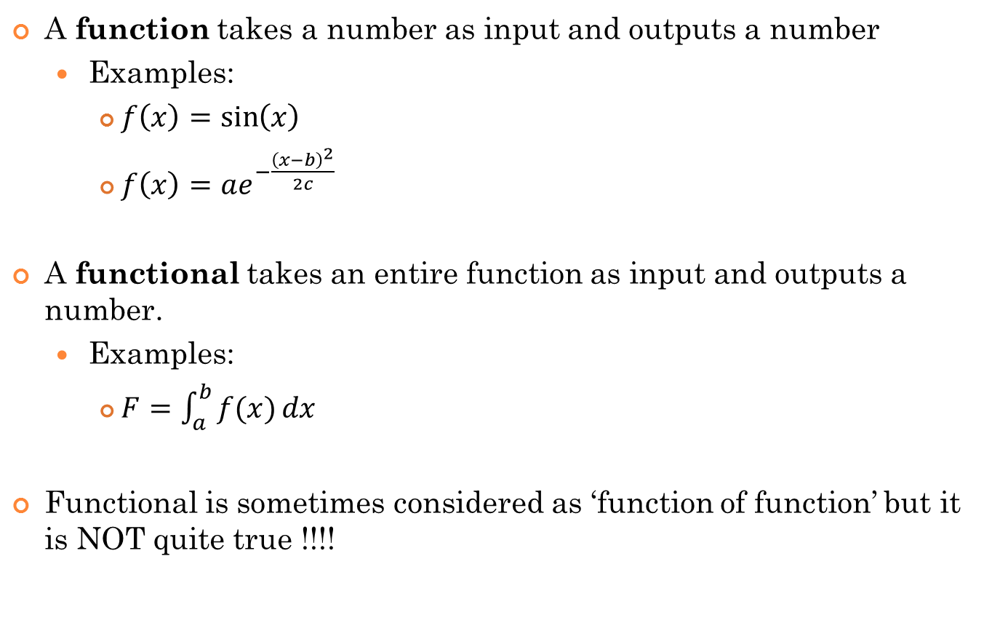
Functions and Functionals
A function takes a number as input and outputs a number
  Examples:
    $f\left(x\right)=\sin\left(x\right)$
    $f\left(x\right)=ae^{−\frac{{\left(x−b\right)}^{2}}{2c}}$
A functional takes an entire function as input and outputs a number.
  Examples:
    $F=\int_{a}^{b}{f(x)}dx$
Functional is sometimes considered as ‘function of function’ but it is NOT quite true !!!!

Slide 26
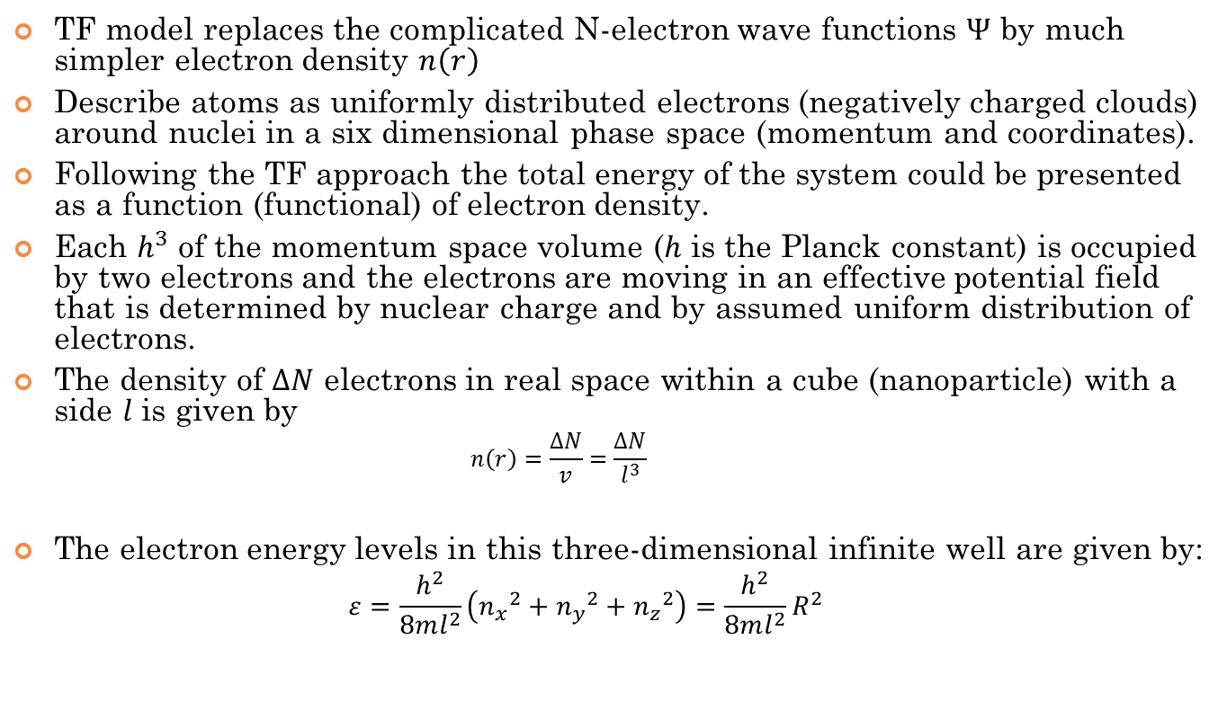
Thomas-Fermi model
Replaces the N-electron wave function by electron density.
Describe atoms as uniformly distributed negatively charged clouds around nuclei in a six dimensional phase space (momentum and coordinates).
Total energy of the system could be presented as a functional of electron density.
Each h³ of the momentum space volume is occupied by two electrons and the electrons are moving in an effective potential field. The density of ΔN electrons in real space within a cube with a side l is given by:

Slide 27
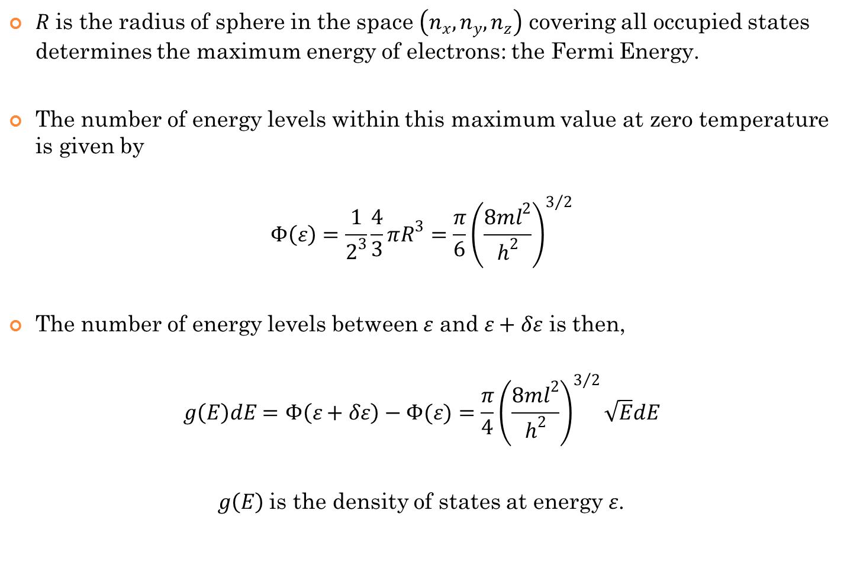
$R$ is the radius of sphere in the space $\left(n_{x},n_{y},n_{z}\right)$ covering all occupied states determines the maximum energy of electrons: the Fermi Energy.
The number of energy levels within this maximum value at zero temperature is given by
$$Φ\left(ε\right)=\frac{1}{2^{3}}\frac{4}{3}πR^{3}=\frac{π}{6}{\left(\frac{8ml^{2}}{h^{2}}\right)}^{3/2}$$
The number of energy levels between $ε$ and $ε+δε$ is then,
$$g\left(E\right)dE=Φ\left(ε+δε\right)−Φ(ε)=\frac{π}{4}{\left(\frac{8ml^{2}}{h^{2}}\right)}^{3/2}\sqrt{E}dE$$
$g\left(E\right)$ is the density of states at energy $ε$.

Slide 28
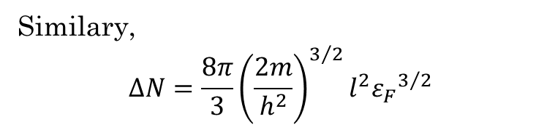
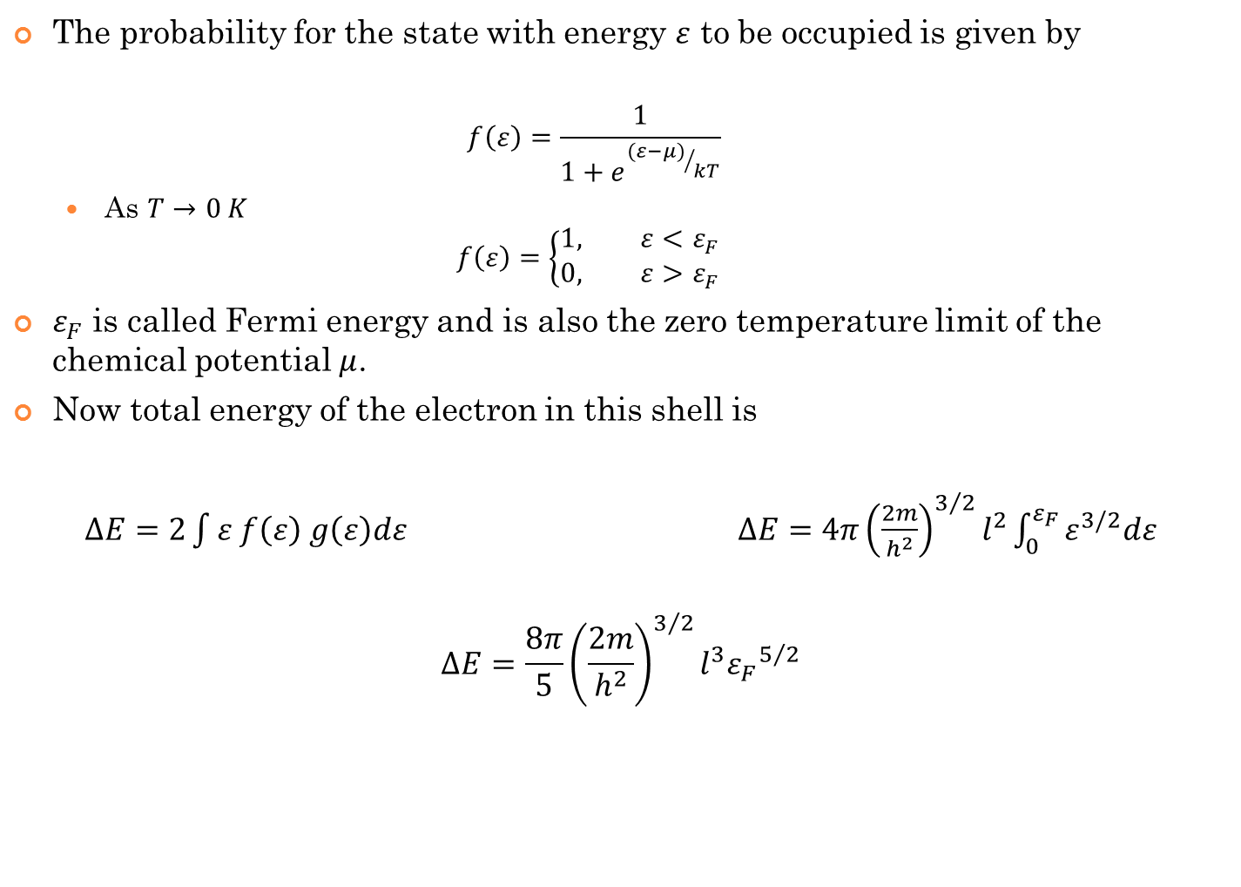
The probability for the state with energy $ε$ to be occupied is given by
  $$f\left(ε\right)=\frac{1}{1+e^{{(ε−μ)}/{kT}}}$$
  As $T→0 K$
  $$f\left(ε\right)=\left\{\begin{aligned}1, ε<ε_{F} \\ &0, ε>ε_{F}\end{aligned}\right.$$
$ε_{F}$ is called Fermi energy and is also the zero temperature limit of the chemical potential $μ$.
Now total energy of the electron in this shell is
$ΔE=2\int{ε f\left(ε\right) g\left(ε\right)dε}$ $ΔE=4π{\left(\frac{2m}{h^{2}}\right)}^{3/2}l^{2}\int_{0}^{ε_{F}}{ε^{3/2}dε}$
$$ΔE=\frac{8π}{5}{\left(\frac{2m}{h^{2}}\right)}^{3/2}l^{3}{ε_{F}}^{5/2}$$
Similary,
$$∆N=\frac{8π}{3}{\left(\frac{2m}{h^{2}}\right)}^{3/2}l^{2}{ε_{F}}^{3/2}$$

Slide 29

What’s in Name?

Slide 30
Density functional theory
First Hohenberg-Kohn theorem:
    The external potential is determined, within a trivial additive constant, by the electron density .
Proof:
  Consider the electron density ρ(r) for the ground state of some N-electron system
  If there were two external potentials v and v’ each giving the same ρ for its ground state, we would have two Hamiltonians H and H’ whose ground state densities were the same although the normalized wave functions ψ and ψ’ would be different.
  Taking ψ’ as the trial function for H problem:
  Taking ψ as the trial function for H’ problem:
  Adding these two inequalities:
  Our initial assumption was wrong !!!

Slide 31
external potential
The nuclear attraction energy part of the electronic Hamiltonian operator is called “external potential” in DFT
“External” because due to the BO approximation we are doing a quantum calculation only on the electrons so the nuclei are “external” fixed objects which exert their Coulomb potential to the electrons

Slide 32
We cannot have two different systems with the same ground state density.
determines N, v and hence all the properties of ground state.
Importance of this: we can write

Slide 33
Density functional theory
Second Hohenberg-Kohn theorem:
    2. The ground state energy can be obtained variationally i.e. the density that minimizes the total energy is the exact ground state density.
  The previous theorem assures that determines it own , Hamiltonian , and wave function .
Let us take this as a trial wave function for the problem
of interest having external potential v.
The variational principle asserts that:

Slide 34
Density functional theory
Assuming differentiability of E[ρ] the variational principle requires that the ground state density satisfies the stationary principle-
Which gives the Euler-Lagrange equation
where μ is the Lagrange multiplier associated with the constraint

Slide 35
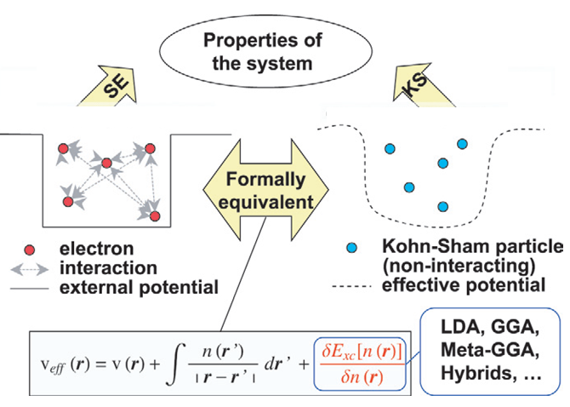
Kohn-Sham Method
Kohn-Sham method:
  Invoked a non-interacting reference system..
  Has same ρ(r) as the real system.
where T_{s}[n] is the KE of the non-interacting system.

Slide 36
Kohn-Sham Method
The Euler-Lagrange equation:
becomes

Slide 37
Kohn-Sham Method
For a non-interacting system, the many electron wavefunction is a single Slater determinant
For this:
and:
The ψ_{i}(r) must be found from a self consistent solution of:
These are called the Kohn-Sham equations.

Slide 38
Kohn-Sham Method
Guess:
Construct
Solve
Find new density:
Look at
Form a better input and continue.

Slide 39
Properties of a quantum mechanical system can be calculated by solving the SE (left part of the figure). A more tractable, formally equivalent way is to solve the DFT KS equations (right part of the figure). However, the exact exchange-correlation functional, E_{xc}[n(r)], is not known. An approximation, such as LDA or GGA, needs to be used, limiting the accuracy of the KS solution.

Slide 40
Kohn-Sham Method

Slide 42
Exchange Correlation Energy
Exchange is the contribution to the energy arising from the antisymmetry of the wave function under permutation of electrons. It prevents two electrons from occupying the same one-electron state and also prevents two electrons of the same spin from coming close to each other; thus it lowers the total electrostatic energy. That lowering is called exchange energy.
While calculating interaction energy of electron by using average potential arising from each electron, we are assuming as if the electrons were a distributed cloud of charge. It is in fact a rapidly moving point charge that tends to avoid the other electrons. The correction of this error is called correlation energy.

Slide 43
Local Density Approximation (LDA)
KS equations exactly incorporate kinetic energy, NOT the exchange correlation functional
An explicit form for exchange-correlation functional is needed to specify KS equations.
Difficult and the greatest challenge in DFT.
Simplest approximation: LDA
Local Density Approximation
Proposed by Kohn and Sham (1965)

Slide 44
Local Density Approximation
Hypothetical uniform electron gas.
Fairly good model for simple metals like sodium.
Pretty far form any realistic situation in atoms or molecules, which are usually characterized by rapidly varying densities.
Why LDA has a prominent role in DFT?
Uniform electron gas is the only system for which we know the form of exchange and correlation energy functionals exactly or at least to vary high accuracy.

Slide 45
Local Density Approximation

Slide 46
Local Density Approximation

Slide 47
Local Density Approximation
Can be calculated Numerically

Slide 48
LDA
Numerical methods

Slide 49
Uniform electron density
Eigenfunctions of electron in 3D box with side l is
With periodic boundary condition

Slide 50
Uniform electron density
Density matrix for doubly occupied spatial orbital is ,
If there is a large number of occupied states, the sum can be replaced by an integral

Slide 51
Uniform electron density

Slide 52
Uniform electron density
Where k_{F} is called Fermi wave vector

Slide 53
Uniform electron density
Introduce a new variable,
If we choose s to lie along k_{z} axis,

Slide 54
Uniform electron density
Where,

Slide 55
Exchange energy functional
The exchange energy functional is given by

Slide 56
The exchange energy functional:

Slide 57
The exchange energy functional:
Let

Slide 58
The exchange energy functional:
Since

Slide 59
DFT beyond lda
For many years, LDA was only approximation available for exchange-correlation energy
The logical first step ahead was suggestion of using not only the information about but to supplement this with information about the gradient of charge density, in order to account for the non homogeneity of the true electron density
In other words, LDA is interpreted as the first term of a Taylor expansion of the uniform density and expect to obtain better approximation

Slide 60
Gradient Expansion
Taylor expansion:
This is called Gradient Expansion Approximation.

Slide 61
Back to LDA !
The GEA does not make significant correction to the LDA
The GEA is even worse than LDA.
Why?
LDA has much more ‘first-principles character’ than GEA.
LDA preserves the properties of exchange correlation holes but GEA does not.
Any further generalization should retain those good features of LDA.
Take a look into the properties of XC holes.

Slide 62
Exchange-Correlation Hole
Consider an electron system interacting through Hartree and XC term alone.
The Hartree term is blind to the spin of electron, the XC term is not.
XC term is manifestation of the Pauli exclusion principle, acts to keep electrons of like spin apart.
If we put a spin-up electron at a point there will be a deficit of other spin-up electron in the neighborhood of the electron.
We can think of each up-spin (down-spin) electron as it is moving through the system as being surrounded by a little bubble of deficit of up-spin (down-spin) electron
This “bubble” is called exchange-correlation hole.

Slide 63
Exchange-Correlation Hole
Define pair-density , which gives probability of simultaneously finding an electron at the point r with volume element dr and another electron at in volume element among other (N-2) electrons in the system
Mathematically it is defined as

Slide 64
Exchange-Correlation Hole
Electron density is given by
Since

Slide 65
Exchange-Correlation Hole
In a classical description the motion of electrons are not correlated, so the probability of finding the pair of electrons at points r and is simply given by a product of the density at the respective points
In reality electrons obey Fermi statistics and so are kept apart quantum mechanically by the Pauli Exclusion principle and also from other non classical coulomb interaction

Slide 66
Exchange-Correlation Hole
The effect of these exchange correlation interaction is to reduce the classical value of electron density at r due to the instantaneous position of the second electron located at r’
Therefore each electron creates a depletion, or hole of electron density around itself as a direct consequence of exchange correlation effects
Taking account of the hole, the pair density can be written as
Where the quantum effects are accounted for by the exchange correlation hole density surrounding each electron located at position r.

Slide 67
Exchange-Correlation Hole
Electron density
Therefore,

Slide 68
Exchange-Correlation Hole
This is normalization condition for exchange-correlation hole and is called sum rule.
Pair-density is a probability, consequently the definition of the pair density implies that
So, the magnitude of the hole density can never be greater than the density at the site of the electron.

Slide 69
Exchange-Correlation Hole
Also we can show that,
All these properties of Exchange-Correlation hole MUST be respected by any kind of approximation we make for exchange correlation energy
The GEA does not preserve these properties.
Therefore we need GGA which satisfies these conditions.

Slide 70
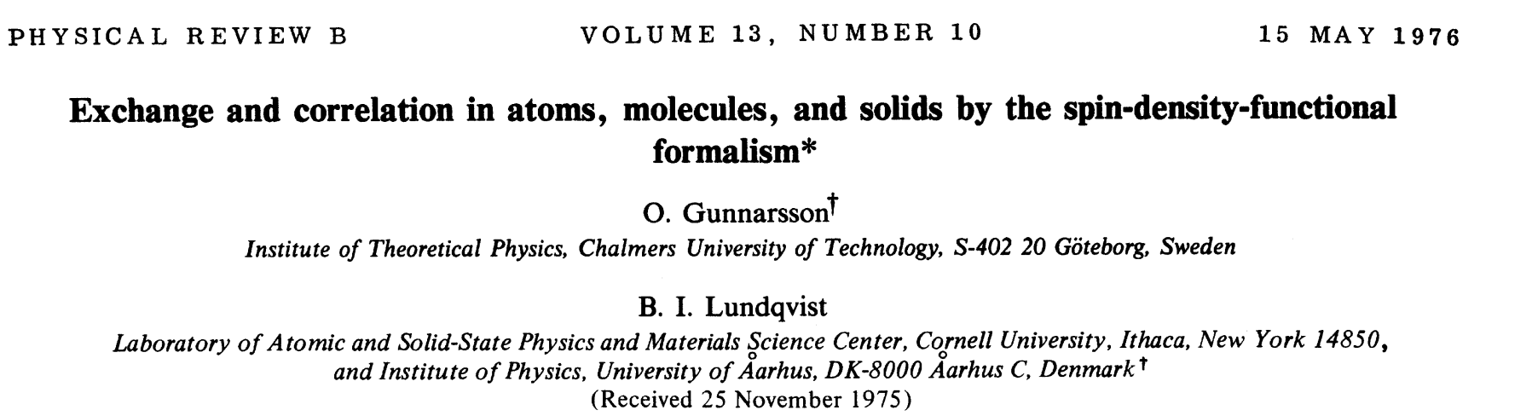
LDA seems to be very crude approximation but it works better than expected.
True reasons for the success of LDA were identified by Gunnarson and Lundqvist, who showed that the LDA preserves certain properties of exact XC holes.

Slide 71
e_{xc} in terms of XC hole
Recall the expression for E_{xc}
Non classical part of electron electon interaction energy
Difference between the Kohn-Sham non interacting K.E. and exact K.E.

Slide 72
e_{xc} in terms of XC hole
Define a functional
Which searches all that yield the input density and then delivers the minimum of
Parameter characterizes strength of electron-electron interaction

Slide 73
e_{xc} in terms of XC hole

Slide 74
e_{xc} in terms of XC hole
From the definition of

Slide 75
e_{xc} in terms of XC hole

Slide 76
e_{xc} in terms of XC hole
Since,

Slide 77
e_{xc} in terms of XC hole
According to LDA,

Slide 78
If we denote the LDA XC hole by
Therefore LDA corresponds to a real physical hole
So we can go back to the definition of hole and show that it satisfies the condition required by it !
Therefore we say LDA preserves properties of a xc hole.

Slide 79
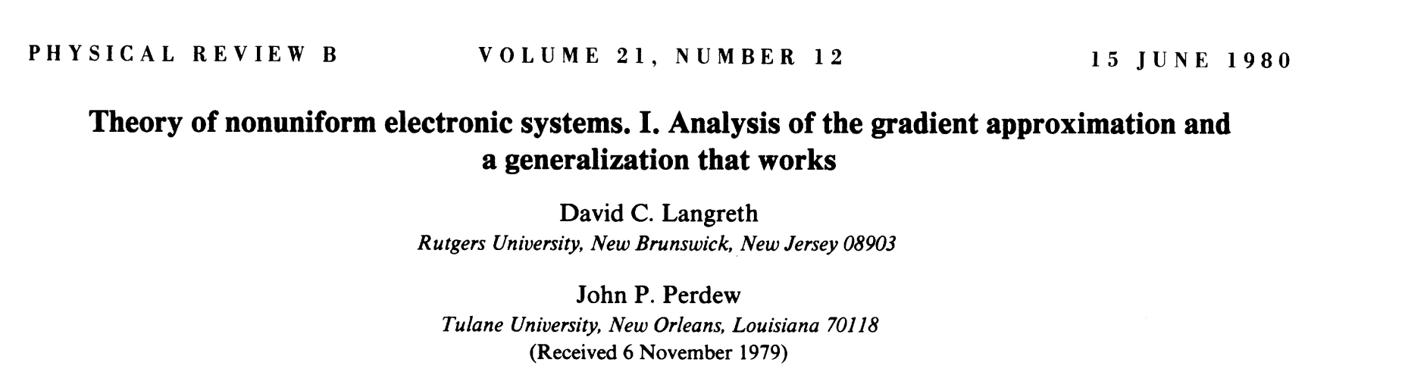
GEA
Langreth and Perdew have explained failure of GEA in their papers.

Slide 80
GEA Exchange hole
Undamped oscillation term
Violets negativity constraint

Slide 81
Generalized Gradient Approximation
The local density approximation (LDA) for the exchange-correlation energy has proved to be remarkably accurate, useful.
The generalized gradient approximation (GGA) is more widely used in quantum chemistry, but LDA still remains a popular way to do electronic-structure calculations in solid state physics.
By construction, LDA is exact for a uniform density, or more generally for a density that varies slowly over space .
More precisely, LSD should be valid when the length scale of the density variation is large in comparison with length scales set by the local density.

Slide 82
Gradient expansions , which offer systematic corrections to LDA for electron densities that vary slowly over space, might appear to be the natural next step beyond LDA.
However, as we discussed- the GEA does not make significant correction to LDA.
LDA preserves the properties of exchange correlation holes but GEA does not.
Any further generalization should retain those good features of LDA.
A brute force fix to the GEA:
  If ρ_{x}(r,r’)>0, set it to zero.
  If sum rule violated, truncate the hole.

Slide 83
One of the main lessons learnt from the works on improvement of approximation is that the gradient expansion has to be carried out very carefully in order to retain all the relevant contributions to the desired order.
And other important lesson is that these expansions easily violate one or more of the exact conditions required for exchange correlation holes.

Slide 84
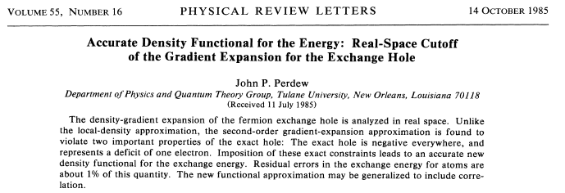
On the basis of this reasoning, a number of modified gradient expansions have been proposed along the years. These modified gradient expansions have received the name of GGA.

Slide 85
The basic idea of GGAs is to express the exchange-correlation energy in the following form:
Where the function F_{xc} is asked to satisfy a number of formal conditions for the exchange correlation hole. This can not be done by considering directly the bare gradient expansion. Therefore there is not a unique recipe.
Not all the formal properties can be enforced at the same time, and this differentiates one functional from another.

Slide 86
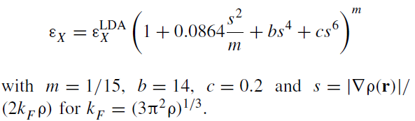
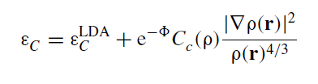
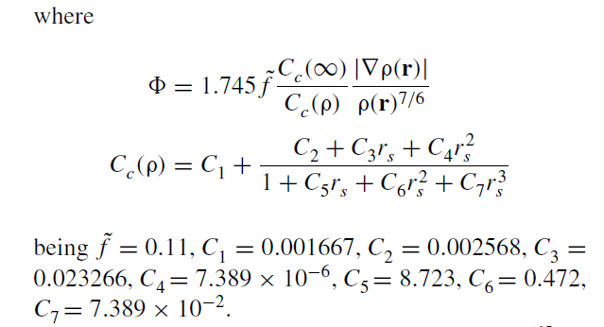
Perdew-Wang 86 (PW86):

Slide 87
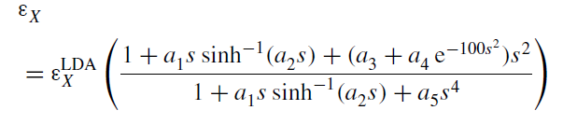

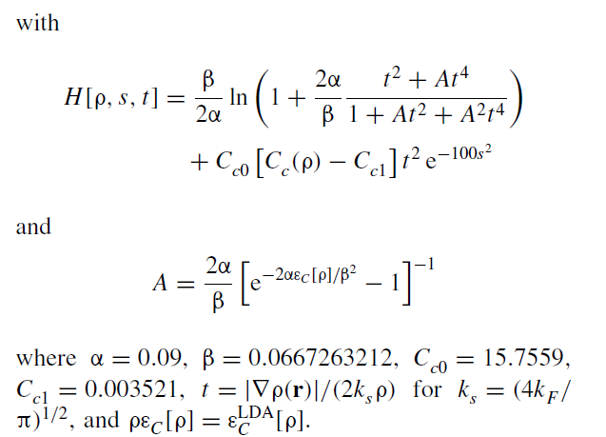

Perdew-Wang 91 (PW91):

Slide 88




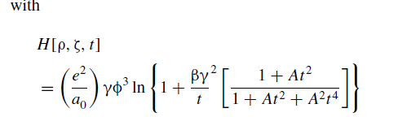
PBE (“GGA made simple”)

Slide 89
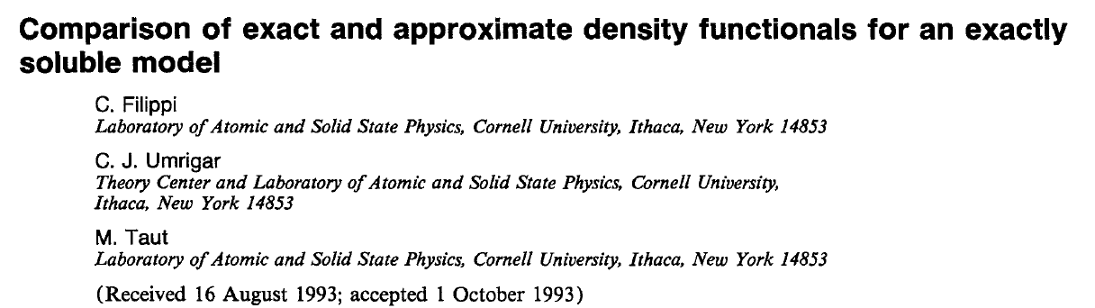
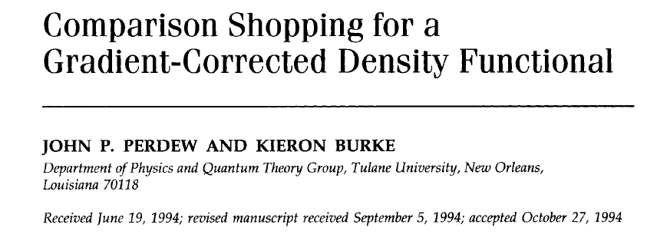

Slide 90
The general trends of GGAs concerning improvements over the LDA are the following:
  They improve binding energies and also atomic energies.
  They improve bond lengths and angles.
  They improve energetics, geometries and dynamical properties of hydrogen bonded systems.
  Lattice constants of noble metals (Ag, Au, Pt) are overestimated. The LDA values are very close to experiment, and thus any modification can only worsen them.
  There is some improvement for the gap, but it is not substantial.

Slide 91
Thank you

